Slide 1

Renewable Energy Technology
By
Dr. Afolabi Kayode Ojo
Department of Science Education
University of Ilorin, Ilorin, Nigeria
afolabi.ko@unilorin.edu.ng
Phone:08036307433

Slide 2
Renewable Energy Technology (RET)
This refers to the multidisciplinary engineering systems, devices, and materials designed to capture, convert, store, and distribute energy derived from naturally recurring, rapidly replenishing environmental flows.

Slide 3

Types of Renewable Energy Technology
Solar Energy: Energy captured from the sun’s electromagnetic radiation.

Slide 4

Types Of Renewable Energy Technology cont…..
2. Wind Energy: Energy generated by tapping into the kinetic movement of air masses caused by the uneven heating of the Earth's atmosphere.

Slide 5

Types Of Renewable Energy Technology cont…..
3. Hydropower: Energy derived from the gravitational flow of water through the hydrological cycle.

Slide 6

Types Of Renewable Energy Technology cont…..
4. Bioenergy (Biomass): Chemical energy stored in organic matter such as agricultural crops, wood residues, and organic waste.

Slide 7
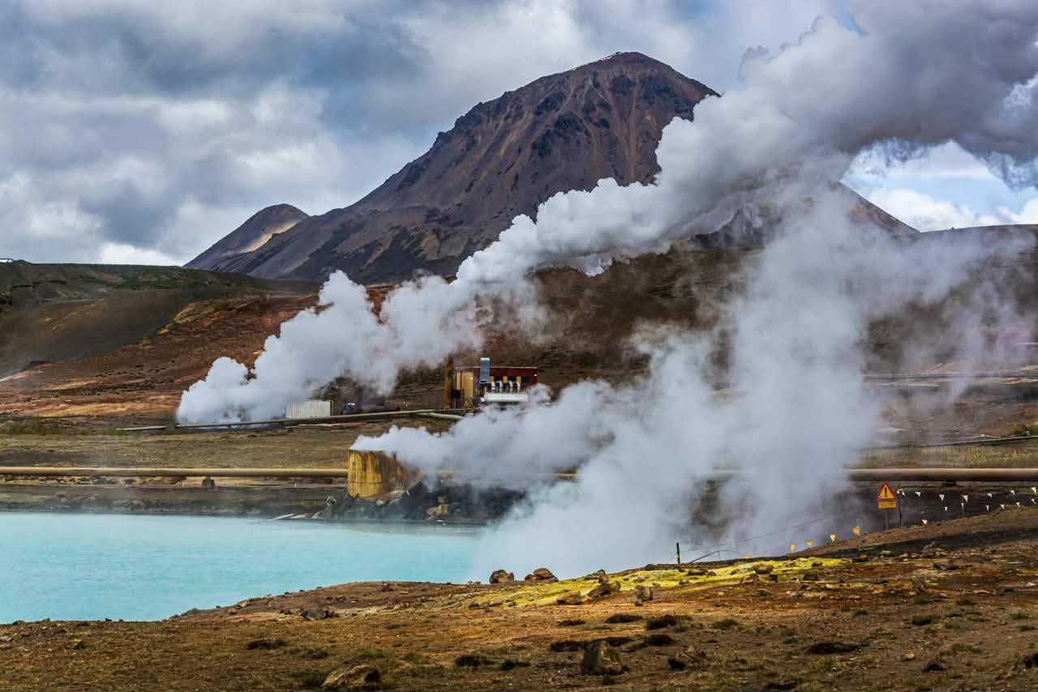
Types of Renewable Energy Technology cont…..
5. Geothermal Energy: Thermal energy originating from the Earth's core, supplied by primordial heat and the radioactive decay of minerals.

Slide 8

Types Of Renewable Energy Technology cont…..
6. Ocean Energy: Energy harvested from the sea through tidal and wave energy.

Slide 9
Socio-cultural and Community Engagement Gaps in Renewable Energy Technology
This refers to the lack of proper understanding, inclusion, participation, and alignment between renewable energy projects within the social or cultural context of the communities where they are utilised.

Slide 10
Socio-cultural gaps
These are problems arising as renewable energy technologies do not always consider people’s culture, beliefs, traditions, and social structures. However, they are influenced by the following:
Lack of awareness or education
Cultural beliefs and traditions
Gender inequality
Affordability and social inequality
Language and communication barriers

Slide 11
Community engagement gaps
These happen when communities are not properly involved in planning, decision-making, or managing renewable energy projects.
Common gaps include:
Top-down project planning
Limited participation
Lack of trust
Poor local ownership
Insufficient training

Slide 12
Benefits of Socio-Cultural Engagement in Renewable Energy Technologies
Accelerates Social Acceptance
Optimizes Technical Design via Local Knowledge
Ensures Long-Term Operational Sustainability
Fosters Fair Distribution of Benefits

Slide 13
Effects of socio-cultural and community engagement in renewable energy
Fail or stop working
Encourages People to Try It
Respects Local Traditions and Livelihoods
Be rejected by the community
Be poorly maintained
Not meet the real needs of the people

Slide 14
Ways to close these gaps
Community participation from the start
Education and awareness programs
Using local languages and culturally appropriate communication
Including women and marginalized groups
Training communities to manage and maintain systems
Developing community-owned energy projects

Slide 15


