Slide 1
INTERDISCIPLINARY AND SYSTEM THINKING GAPS
BY
DR.HAFSAT I. ALABI

Slide 2

Interdisciplinary and Systems Thinking
Revolutionizing Renewable Energy for Institutional Sustainability

Slide 3


The Burden of Irregular Power
Irregular electricity supply unpredictably hinders academic life across faculties in developing countries:
Science/Engineering: Interrupted laboratory experiments.
Law/Arts: Limited access to digital databases.
Agriculture: Failure of field and processing gear.
Education: Integration gaps in ICT teaching.

Slide 4
A Holistic Vision
Adopting renewable energy through interdisciplinary collaboration and systems thinking to contribute to a sustainable world.

Slide 5
Course Learning Objectives
Explain key principles of systems thinking in energy analysis.
Analyze components, relationships, and feedback loops.
Integrate methods from multiple disciplines for real-world solutions.
Design sustainable and context-sensitive electricity solutions.
Reflect critically on the limitations of single-discipline approaches.

Slide 6
What is Systems Thinking?
"Systems thinking helps us understand how elements interact and shape system behavior... it connects different forms of learning to understand complexity."
— Donella H. Meadows, Thinking in Systems
It isn’t just about "making electricity"—it’s about managing heat, entropy, and social behavior as a connected whole.

Slide 7







Diverse System Dimensions
Biological
Social
Technological
Ecological
Living systems like crops and forests; key to Bioenergy production and ecological impacts.
Communities, markets, and policy; focuses on public willingness to accept projects.
Engineering aspects of solar grids, battery storage, and energy distribution design.
Impact of climate systems on energy networks and environmental sustainability.

Slide 8


Components and Boundaries
System Elements
System Boundaries
Elements: Panels, inverters, batteries.
Narrow Boundary: Focuses only on technical equipment.
Interconnections: Energy transfer and feedback.
Broad Boundary: Includes technology, policy, finance, social behavior, and environment.
Purpose: Reliable electricity production.

Slide 9
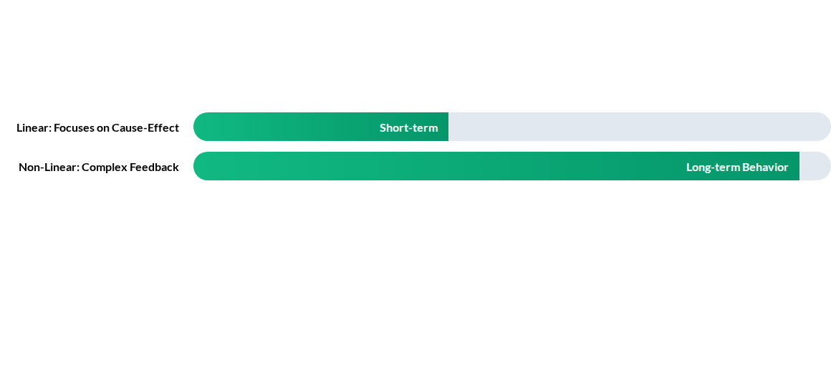
Linear vs. Non-Linear Thinking
Linear: Install solar panels → generate electricity. (Simple but limited).
Non-Linear: Policy changes → market response → social adoption → grid impact. (Realistic and complex).

Slide 10
Interdisciplinary Matrix
Discipline | Systems Contribution
Engineering | Design, integration, and reliability of smart grids and storage.
Law | Regulatory compliance, rules, incentives, and institutional design.
Arts | Cultural narratives, public perception, and aesthetic engagement.
Education | Curriculum development, building mental models, and awareness.
Entrepreneurship | Business models, innovation, and value creation in energy markets.
ICT | The "nervous system"—Smart meters and IoT feedback loops.

Slide 11

The Power of Synergy
Beyond Technical
A purely technical approach might give you efficient solar panels that never get adopted.
An interdisciplinary approach asks: Will policy support it? Will people use it? Can a business make it viable? What does it mean for the planet?

Slide 12
Targeting Global Goals
07
13
Affordable & Clean Energy
Climate Action
Adopting these solutions reduces fossil fuel dependence, promotes innovation, and enhances inclusive learning across higher education.

Slide 13
Questions?
Thank you for exploring the interdisciplinary future of energy.
SYSTEMS THINKING | SUSTAINABILITY | INNOVATION

Slide 14


Image Sources
https://solarcool.com.ng/wp-content/uploads/2025/10/WhatsApp-Image-2025-10-14-at-12.37.46-PM.jpeg
Source: solarcool.com.ng
https://nsf-gov-resources.nsf.gov/styles/_inline_image_full_width/s3/media_hub/DMR-hero-image-workforce-development.jpg?itok=HZyz_WPK
Source: www.nsf.gov

