Slide 1
Creativity, Innovation, Entrepreneurial Opportunities in Renewable Energy
By
Dr. Philips Adebayo, PhD
Department of Business and Entrepreneurship,
Kwara State University Malete, Malete Nigeria.
E-mail: philips.adebayo@kwasu.edu.ng,
Phone Number: 07038192900

Slide 2
CREATIVITY
Creativity is about creation. It is a process of bringing things to be in forms and ways that they are not known to be prior to that time.
It is putting to use the creative senses of man to force a change through a new process or product, expected to solve identified needs in the society.
Creativity is the activity of life that brings about progress and development in the society.

Slide 3
CREATIVITY
Creativity is, therefore, the process of generating novel (new) and appropriate (relevant) ideas.
It is the breaking down of prior assumptions and making new connections for new ideas.
Creativity therefore changes the old process, introduces new ways and new products hence accelerating the pace of change in organizations and the society in general.

Slide 4
Innovation
Innovation, on the other hand, is the process of implementing the creative ideas in an attempt to bring about changes in the order of things.
Innovation transforms the new ideas created into acceptable products, hence bringing about corporate and marketplace realities.
The capacity to make real our creative thinking is what we refer to as innovation.

Slide 5
Innovation Cont’d
Innovation is all about transforming creative ideas into products that are acceptable to the market.
In other words, it is not all about being able to create a product, but creating a product that has a market, meets the needs of the identified customers referred to as the target market.
The product of innovation should meet the needs of the target customers for it to be acceptable to the market, and attract an acceptable price.

Slide 6
THE SEARCH FOR NEW IDEAS:
Idea, Opportunity and Opportunity recognition
An idea is a thought, an impression, or a notion. It may or may not meet the criteria of an opportunity.
Opportunities are ideas that have commercial potentials.
An opportunity is a favorable set of circumstances that creates the need for a new product, service, or business idea.

Slide 7
Things to note:
The difference between an opportunity and an idea is that:
  An idea is “Something imagined or pictured in the mind”. While opportunities are idea with potential commercial values. Therefore, an idea may or may not represent an opportunity.

Slide 8
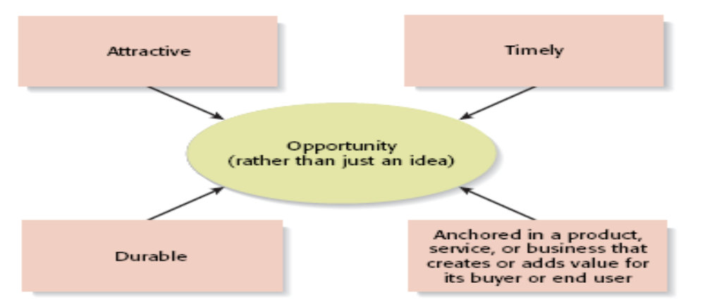
Components of An Opportunity

Slide 9
Entrepreneurial Opportunities
Opportunities come from many sources
  Start-ups
    Current or past work experiences
    Hobbies that grow into businesses or lead to inventions
    Suggestions by friends or family
    Chance events
    Change

Slide 10
Entrepreneurial Opportunities Cont’d
Opportunities come from many sources
  Established firms
    Needs of existing customers
    Suggestions by suppliers
    Technological developments that lead to new advances
    Change

Slide 11
Opportunity Identification
Opportunity identification is central to entrepreneurship and involves:
  The creative pursuit of ideas
  The innovation process
The first step for any entrepreneur is the identification of a “good idea.”
  The search for good ideas is never easy.
  Opportunity recognition can lead to both personal and societal wealth.

Slide 12
Entrepreneurial Opportunities in Green and Renewable Energy for Young People
Solar Energy Development - Nigeria has abundant sunlight throughout the year, creating a major opportunity for large-scale solar farms, rooftop solar systems, and solar mini-grids. Solar energy can help address electricity shortages, especially in rural and off-grid communities.
Mini-Grid and Off-Grid Electrification - Many rural areas in Nigeria remain without access to reliable electricity. This creates opportunities for entrepreneurs and investors to develop renewable energy mini-grids and off-grid power systems using solar, small hydro, or hybrid solutions to serve underserved communities.

Slide 13
Entrepreneurial Opportunities in Green and Renewable Energy for Young People ….Cont’d
Renewable Energy Startups and Innovation - The renewable energy sector provides opportunities for innovative startups working in areas such as solar home systems, energy storage, smart grids, and clean energy financing models like pay-as-you-go solar solutions.
Job Creation, Green Recycle and Green Skills Development - Growth in renewable energy can generate employment opportunities in manufacturing, installation, maintenance, research, and technical services. This also creates opportunities for training programs in green technologies and renewable energy engineering.

Slide 14
Entrepreneurial Opportunities in Green and Renewable Energy for Young People ….Cont’d
Investment and Public–Private Partnerships - Nigeria’s renewable energy sector offers strong opportunities for domestic and foreign investment, particularly through public–private partnerships (PPPs), international climate finance, and development programs supporting clean energy projects.
Green & Renewable Energy Advocacy, Research & Policy Making- The Nigeria’s renewable energy sector is still emerging with lots of research, advocacy and policy gap. Young people can develop a passion for research and advocacy in this sector. Through a formidable voice, social innovation can erupt which can shift policy target over time.

Slide 15
Qualities of a Creative Person
According to him, (Golder 2009) People who exhibit creative behaviour do these:
challenge the status quo - confront assumptions 0 exhibit curiosity 0 tend to think visually 0 are able to cope with paradoxes 0 look beyond the first ‘right idea’
like to investigate new possibilities 0 tend to take the initiative in most matters
are highly imaginative 0 are future-orientated 0 see possibilities within the seemingly impossible 0 are not afraid of taking risks 0 are prepared to make mistakes
0 are adaptable to different work environments 0are adaptable to changing circumstances 0 see relationships between seemingly disconnected elements
distil unusual ideas down to their underlying principles are able to spot underlying patterns in events

Slide 16
Conclusion
To strengthen Nigeria’s energy ecosystem thereby developing the energy sector, it is essential to address institutional knowledge gaps that hinder innovation and business development in the subsector especially among young people.
Bridging this knowledge gaps in Nigeria’s renewable energy sector requires stronger capacity building for policymakers and regulators, improved institutional coordination, and greater investment in research and data systems.
By investing in capacity building, evidence-based policymaking, regulatory reforms, and stronger institutional coordination, Nigeria can create a more enabling environment for energy entrepreneurs and innovation, thereby accelerating economic diversification and sustainable development.

Slide 17
Q&A
Thank You

